Slide 1
Best Musical Instruments Manufacturers in Delhi
Phone: 01141516141, 01123327685
Mail: info@rikhiram.com
Our vision promote and spread our rich Indian Musical culture around the world
Visit: https://www.shop.rikhiram.com/

Slide 2
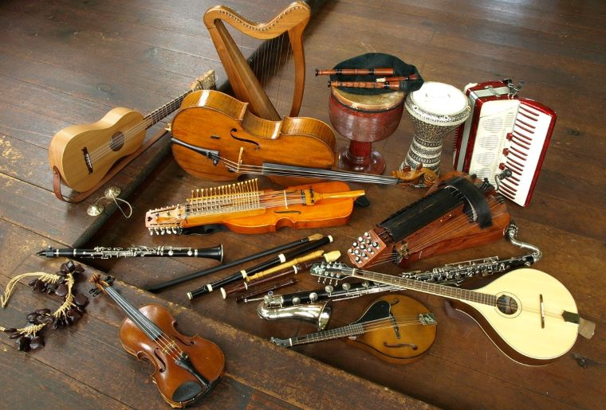
Phone: 01141516141, 01123327685
Mail: info@rikhiram.com
Visit: https://www.shop.rikhiram.com/

Slide 3
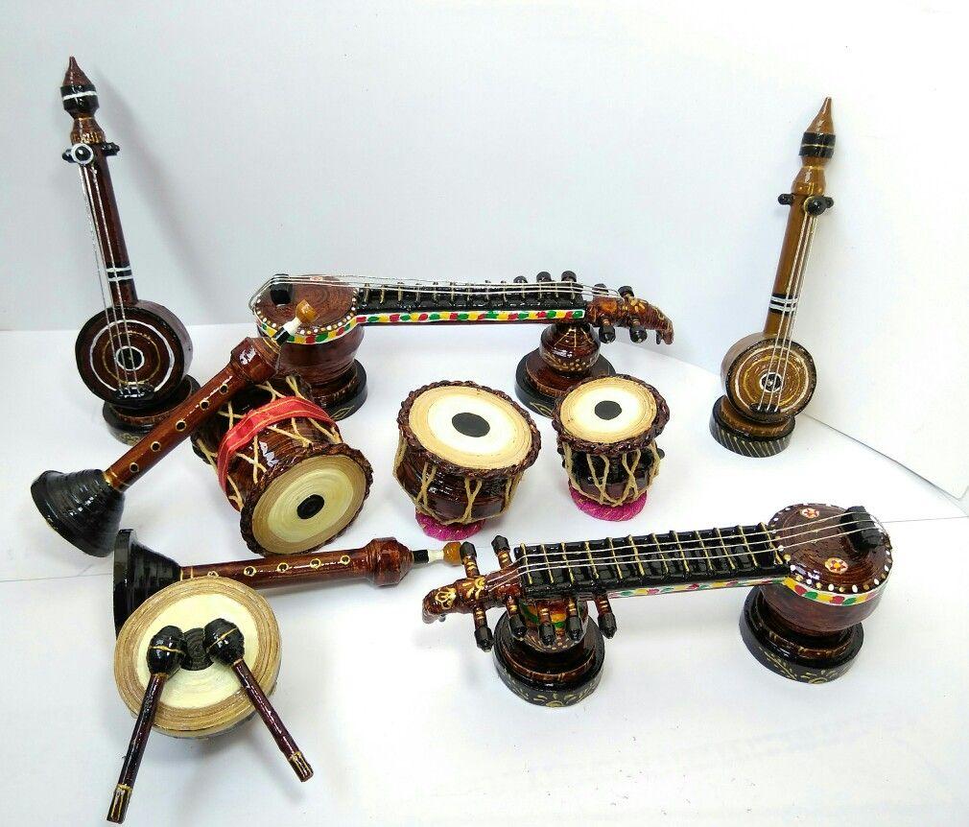
Phone: 01141516141, 01123327685
Mail: info@rikhiram.com
Visit: https://www.shop.rikhiram.com/

Slide 4
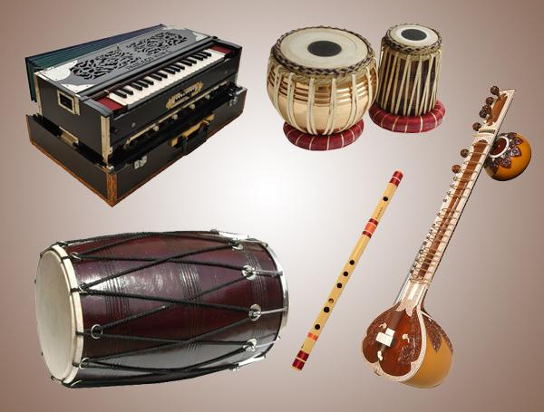
Phone: 01141516141, 01123327685
Mail: info@rikhiram.com
Visit: https://www.shop.rikhiram.com/

Slide 5
Contact Us
Address: G-8 Marina Arcade, Connaught Circus, New Delhi, Delhi 110001
Phone: 01141516141, 01123327685
Mail: info@rikhiram.com
Web: https://www.shop.rikhiram.com/

